Slide 1
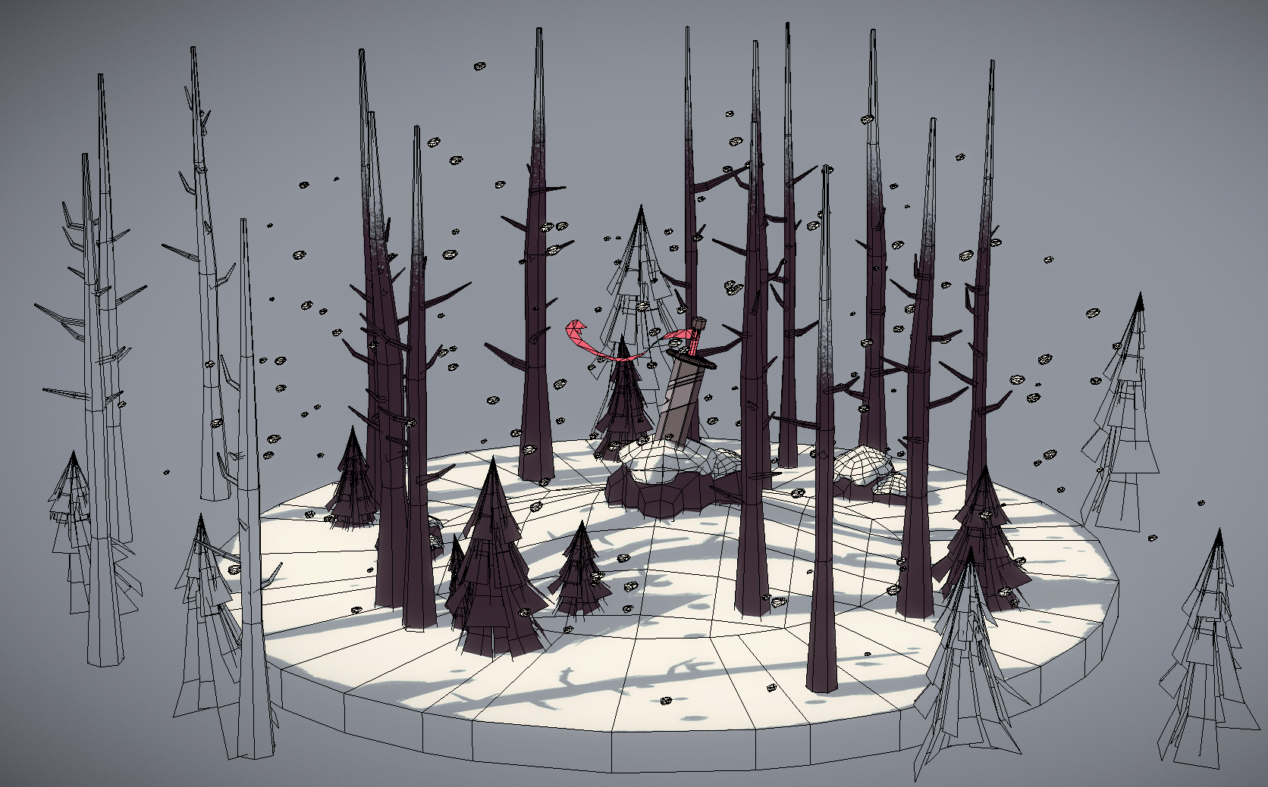

3D Modeling for Game Development
1
Final Project Information

Slide 2
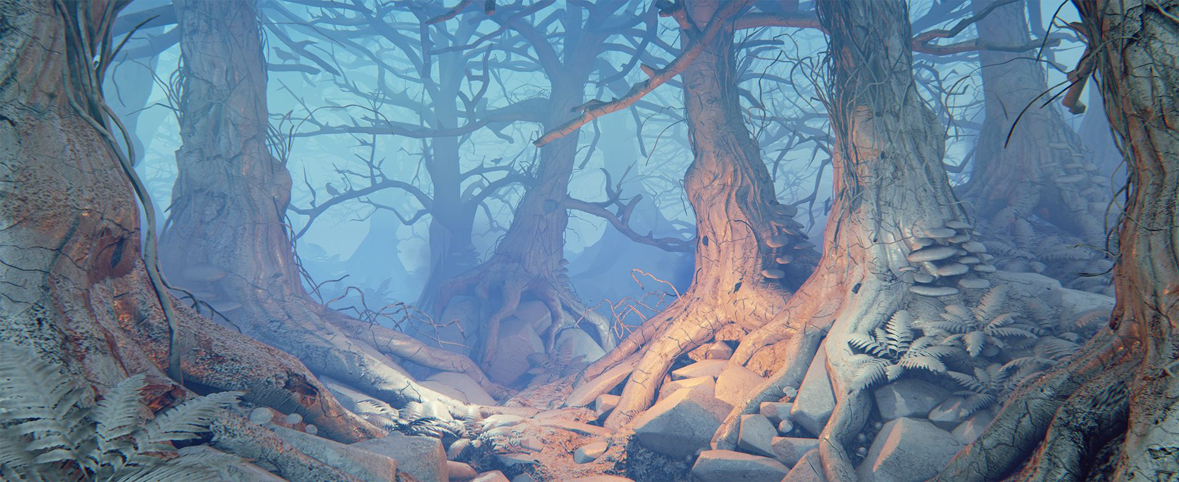
What is the final project?
2
Final Project is a mini diorama scene and will consist of:
3D Elements
A 3D model weapon (sword, battle axe, etc)
At least two 3D models of plant foliage (plant life, trees, mushroom, flowers, etc)
One 3D model of ground and elements (grass hill, snow mound, tree log, rocks)
Texture Elements
Each 3D model must have UV’s setup
Each 3D model must have a hand painted texture map (diffuse & one other type)
No textures must exceed 1024 x 1024 size, (can use smaller texture sizes if you wish)
Game Engine Elements
Must be properly setup in Unity Engine and run when played
Must have a light source
Must have a camera on scene elements, don’t make me search for where the diorama is … must be ready to view.

Slide 3
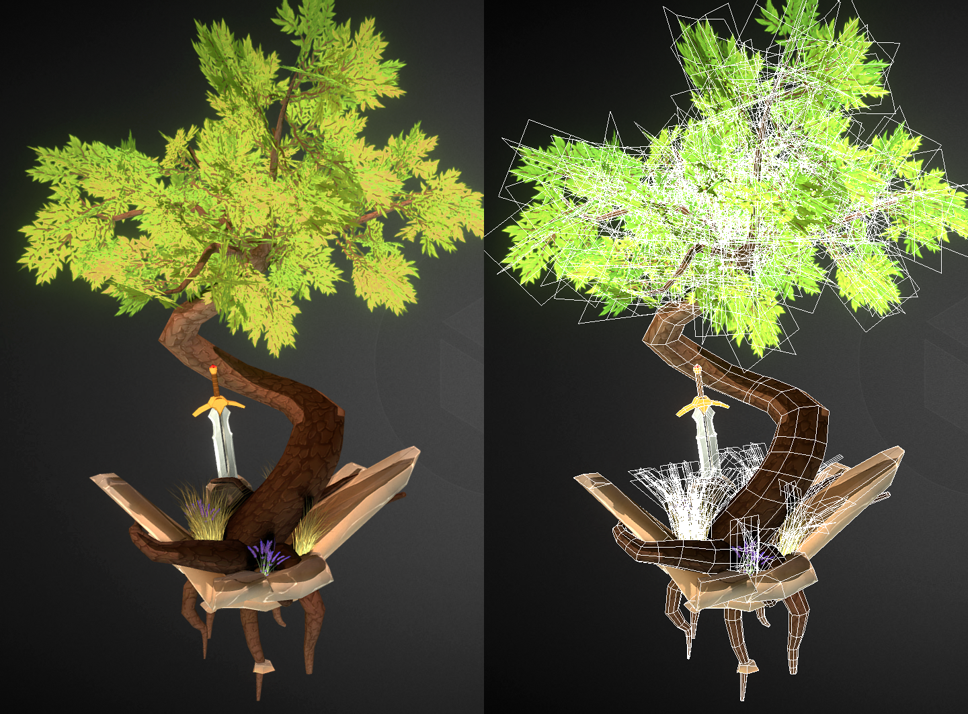
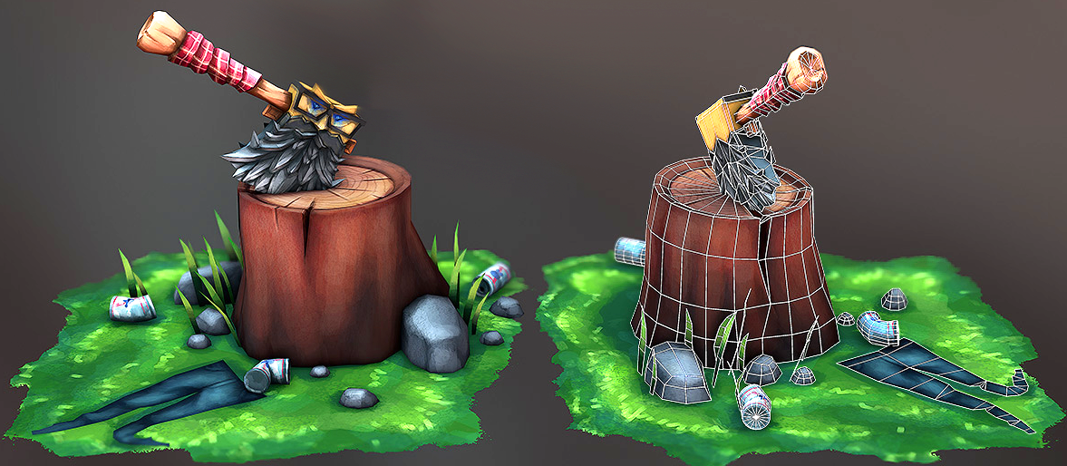
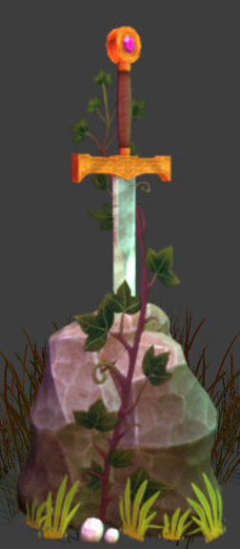
Progress along to final project
3
Starting from week 5 the assignments and homework will be aimed to help students learn the modeling and texturing practices plus the tools to
use on the final project.
Students are welcome to rework any 3D assets or textures as they like if they so desire to improve them from earlier weeks.
But having a completed diorama running inside of Unity Engine by the end of the semester is expected.

Slide 4
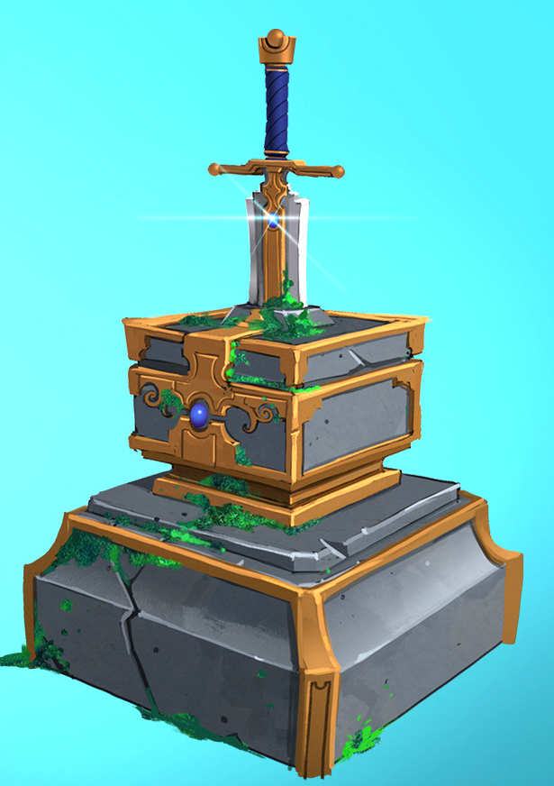
Final project overview
4
Week 5 Box Modeling Practices
Assignment to create a low poly weapon
Week 7 UV Layout
Assignment to layout UV’s for low poly weapon
Weeks 8 & 9 Texturing
Assignment to paint texture for low poly weapon
Weeks 10 & 11 Material Setup & Export to Game Engine
Assignment to setup material for low poly weapon and export into Unity
Weeks 12, 14 & 15 Modeling Foliage & Other Assets
Assignment to create a low foliage and another 2 weeks to finish up the final

Slide 5
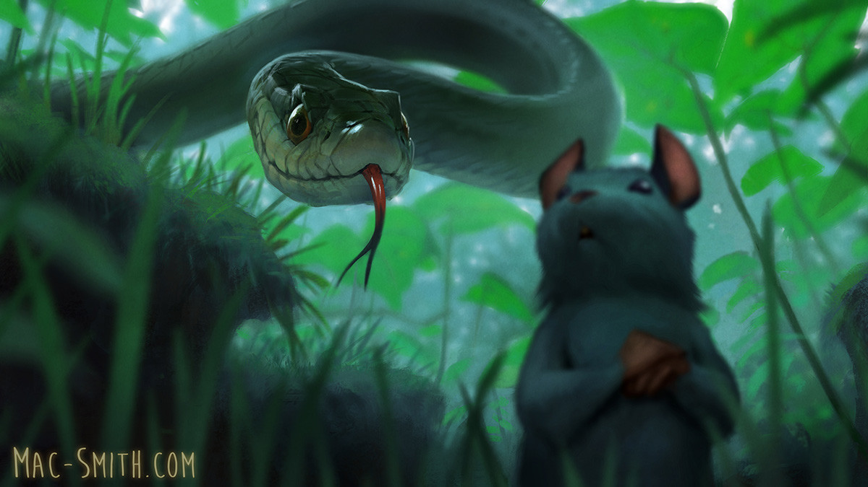
Final project files
5
Students will submit the final project files in a folder with their name and the following:
Unity scene file properly labeled naming convention. i.e. final_diorama_yourName.unity
All final texture files not exceeding 1024 x 1024 map sizes with clean naming conventions. i.e. sword_diffuse.tga
All final 3D max files for each 3D asset found in the diorama with clean naming conventions. i.e. plant_01.max

Slide 6
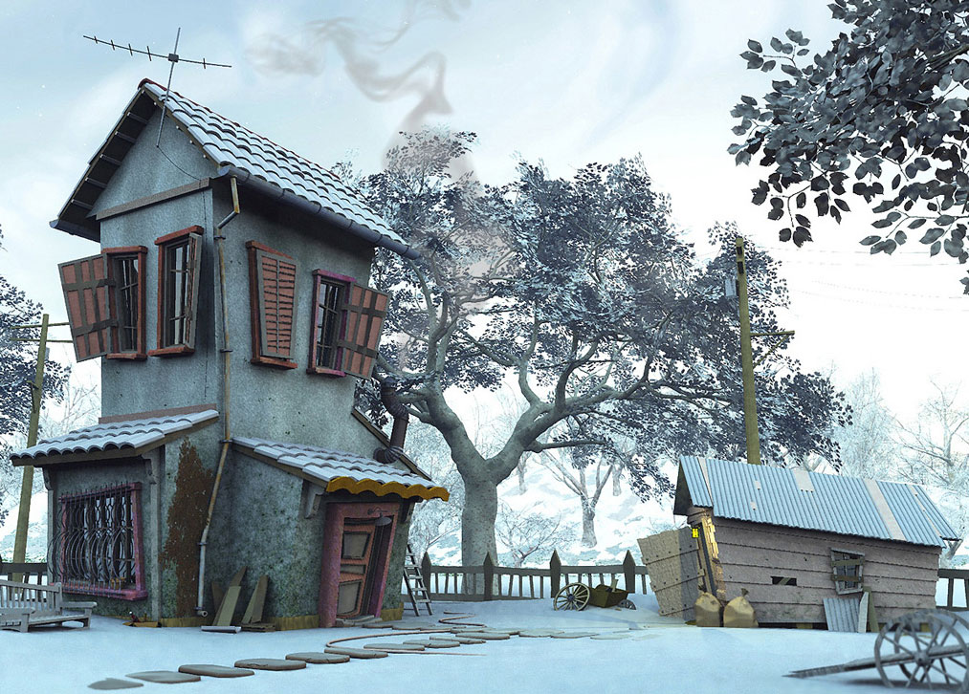
- Mandatory to Pass the Class -
6
All assignments are mandatory in order to pass the class & must be turned in & completed by their deadline.
Final project must be done & meet minimum requirements by the end of the semester.
95% attendance is required to pass the class.
If you have any responsibility to maintain your GPA such as Visa, scholarships, apartment rental or other, make sure you do all assignments and work closely with Mr. Zak. No grade increases will be given at the end of the semester to satisfy a need that is your responsibility.

